Slide 1


Behavioral Risk Factor Surveillance System

Slide 2

Established in 1984
Sponsored through the CDC and other federal agencies
Collects data across the United States
Completes over 400,000 interviews each year
Notes:
The Behavioral Risk Factor Surveillance System is a collaborative project between all states in the U.S. and the CDC.
It is the nation’s premier system of health-related telephone surveys that collects data about U.S. residents regarding their health-related risk behaviors, chronic health conditions, and use of preventive services.
Established in 1984, the system completes more than 400,000 interviews of adults each year, making it the largest continuously conducted health survey system in the world.
The results of the surveys are combined and made available to the public through the CDC’s website.
This data has become a powerful tool to help the nation and individual states establish and track local health objectives, plan health programs, implement disease prevention and health promotion activities, and monitor trends.
Nearly two thirds of states use BRFSS data to support health-related legislative efforts.
Source:
-https://www.cdc.gov/brfss/about/index.htm

Slide 3
Questions
What percent of adults aged 18 years and older have obesity?
What percent of adults achieve at least 150 minutes a week of moderate exercise or 75 minutes a week of vigorous exercise?
These 2 questions were analyzed by:
Income
Sex
Geography
Time

Slide 4
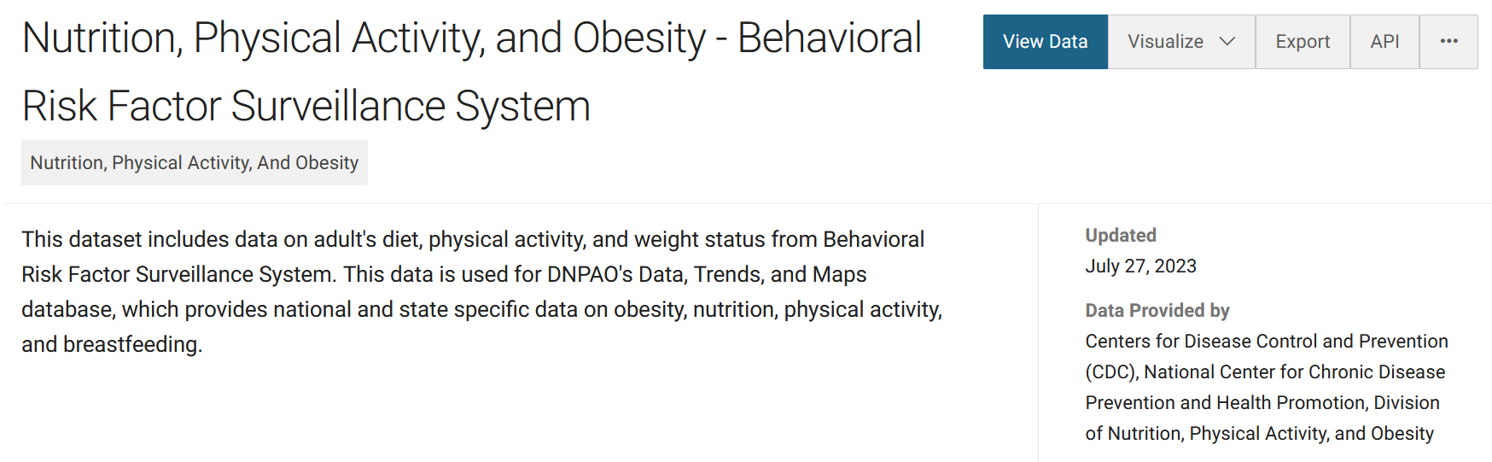
Dataset
https://data.cdc.gov/Nutrition-Physical-Activity-and-Obesity/Nutrition-Physical-Activity-and-Obesity-Behavioral/hn4x-zwk7
Cleaning Required:
Null Values, Error Values, Combination Columns (Geography, Stratification)

Slide 5
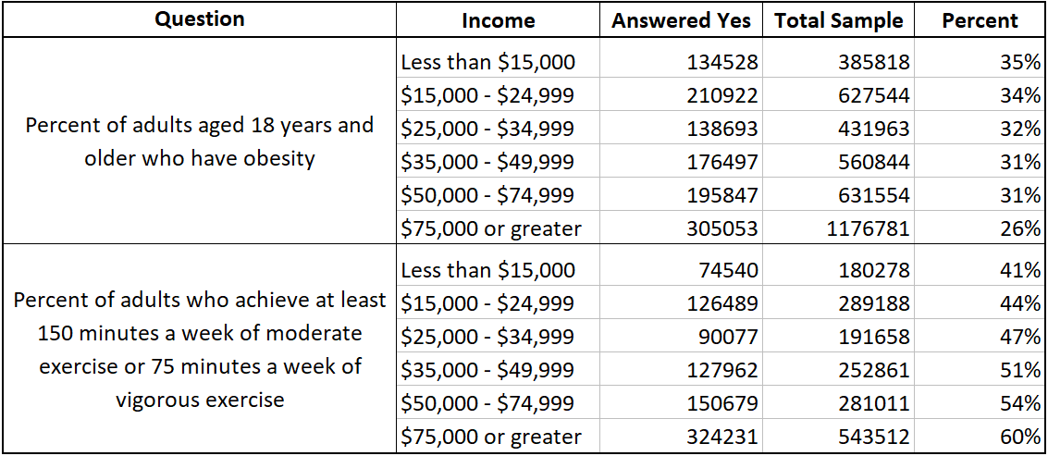
Income

Slide 6
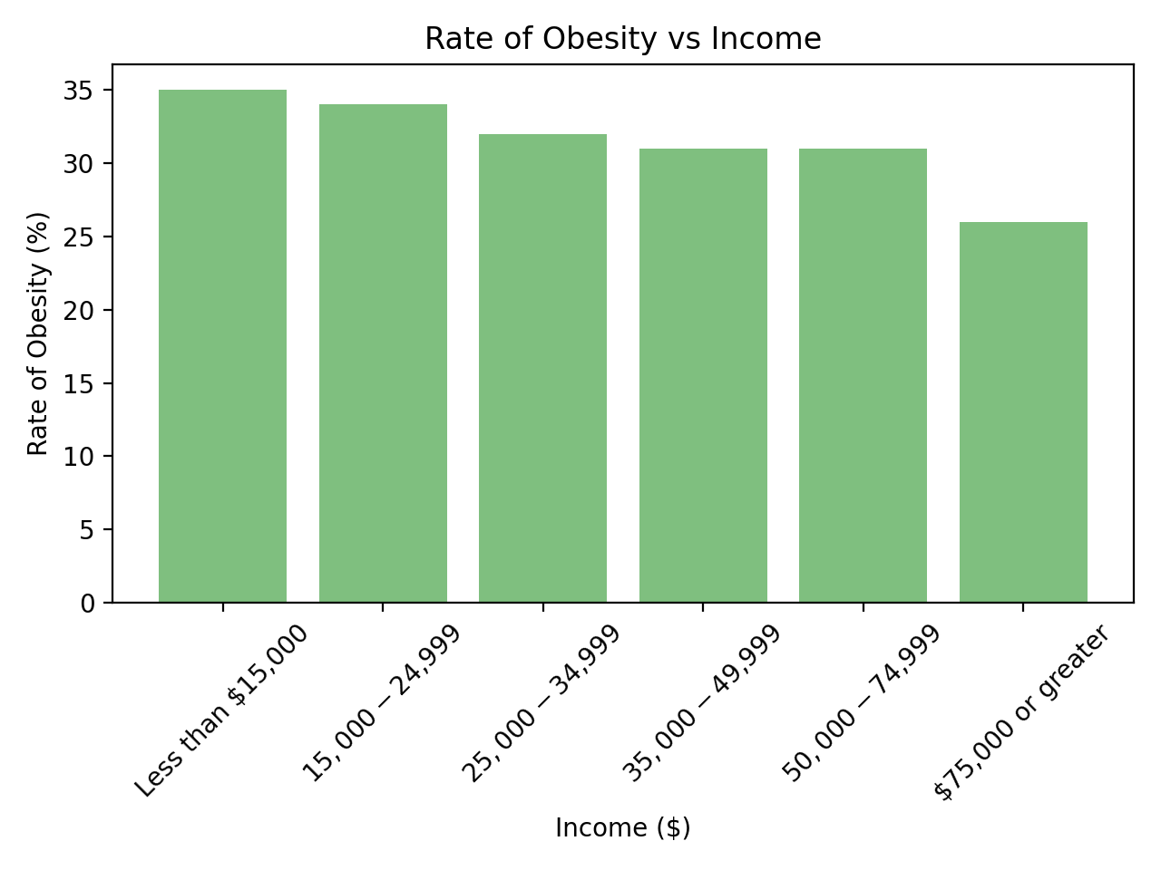
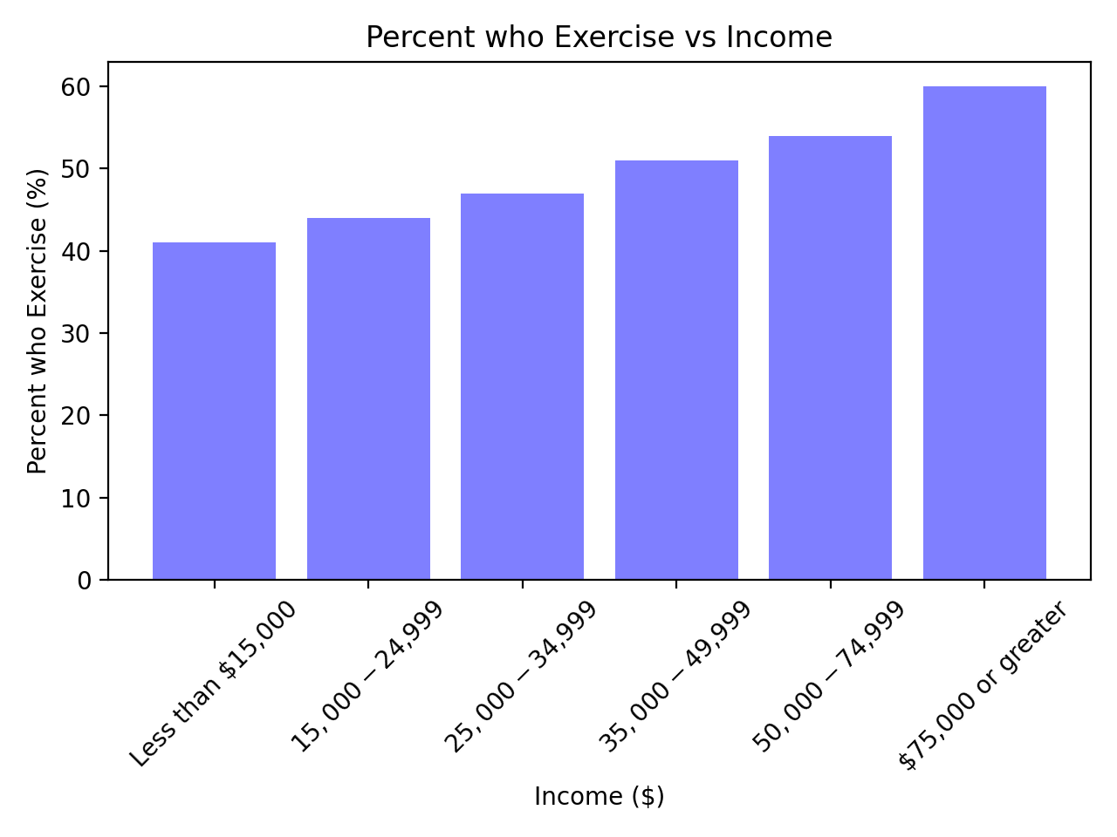
Income
r = -0.95
r = 0.99

Slide 7
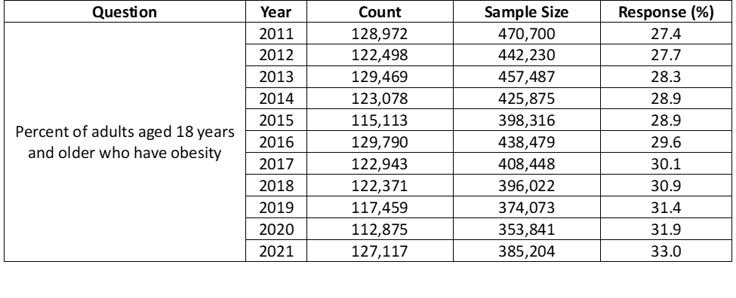
U.S. Obesity Rate Over Time

Slide 8
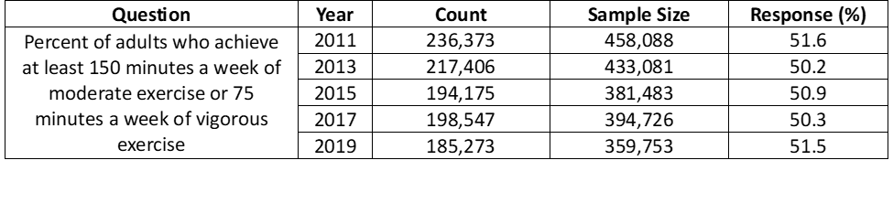
Physical Activity Over Time

Slide 9
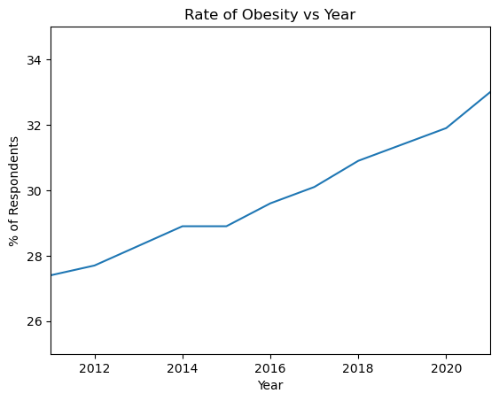
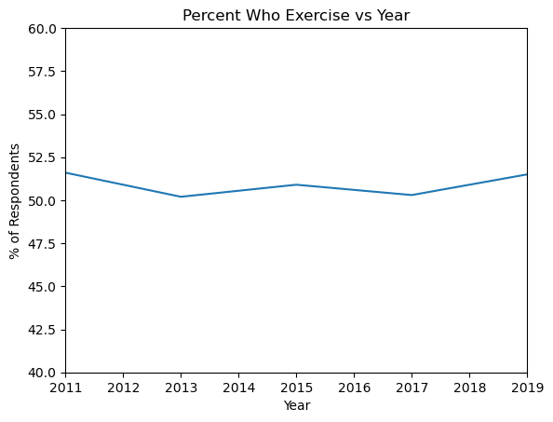
Year

Slide 10
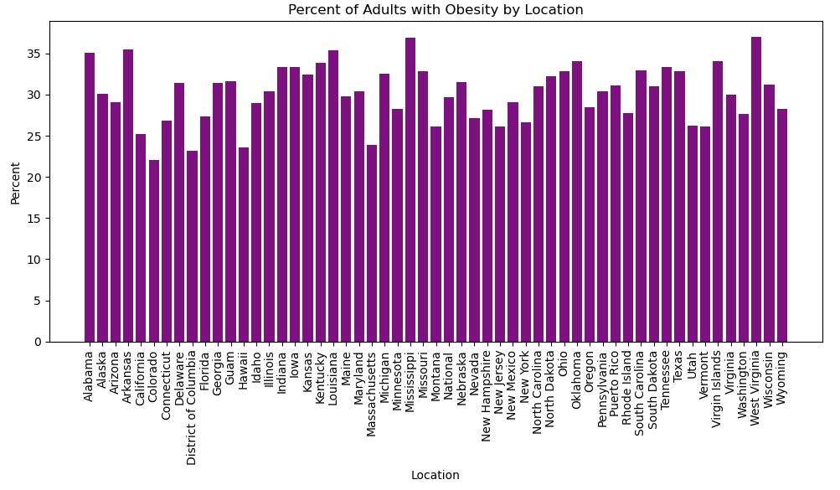
Location

Slide 11
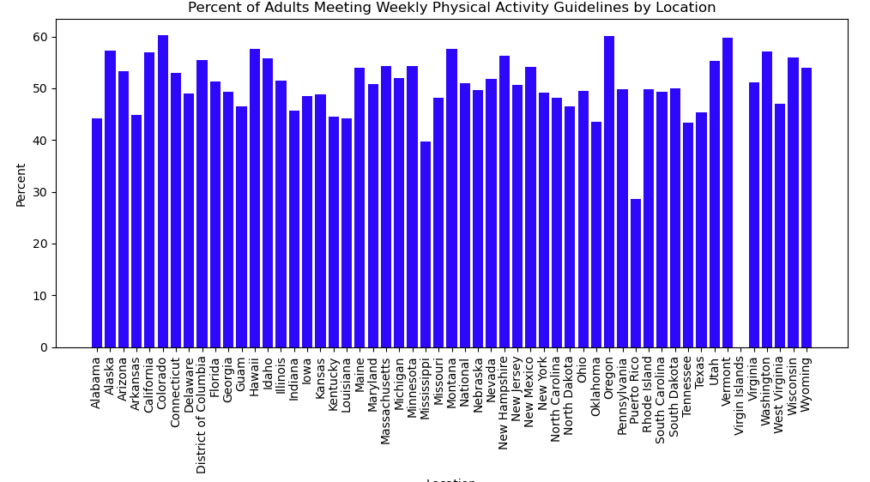
Location

Slide 12
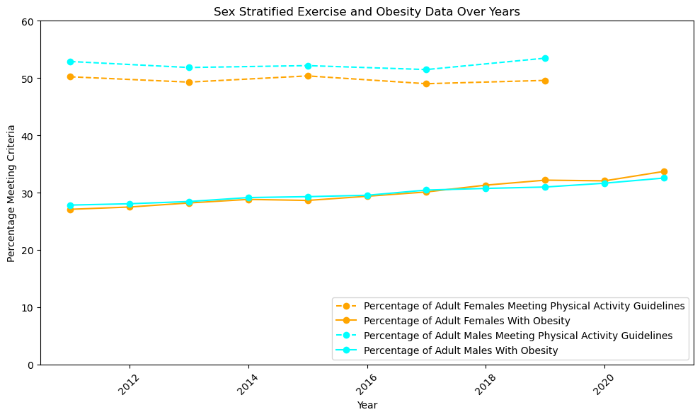
Gender

Slide 13
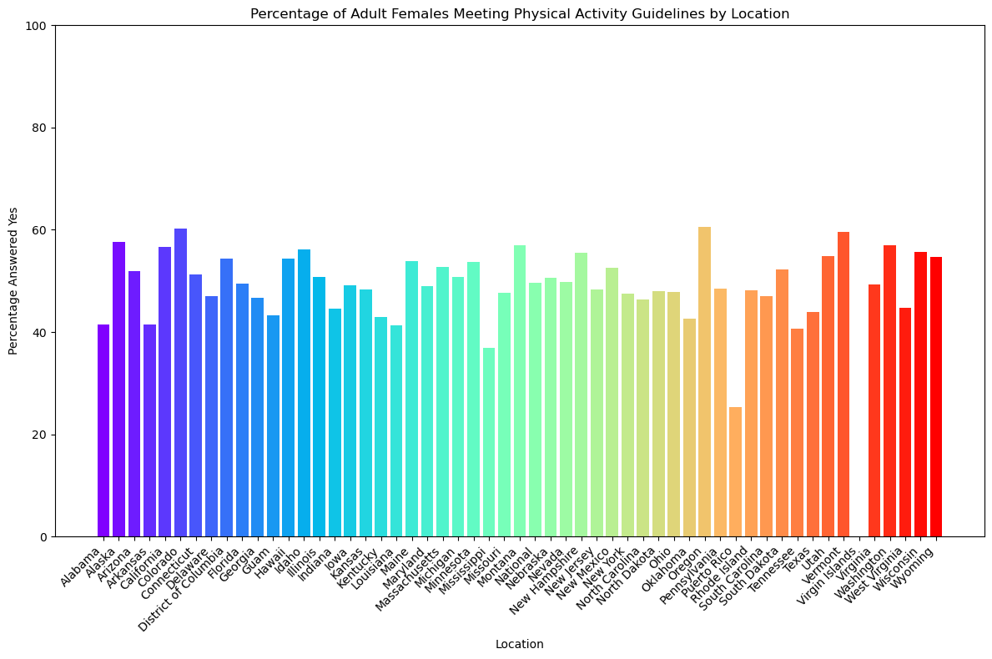
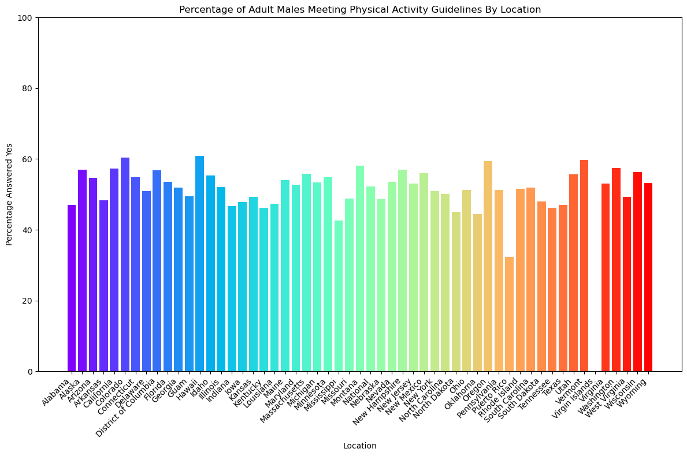
Gender

Slide 14
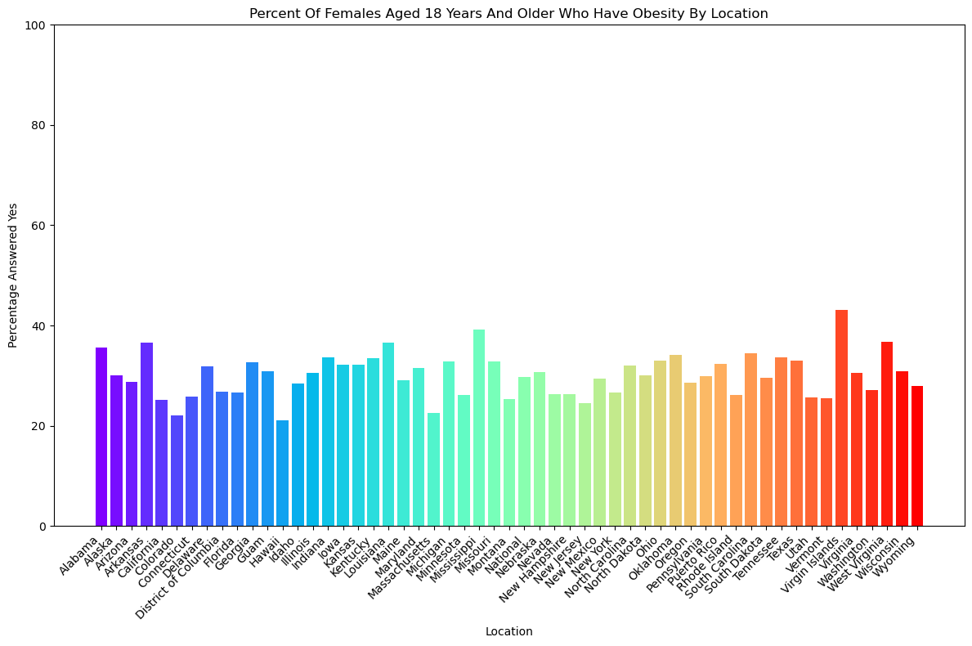
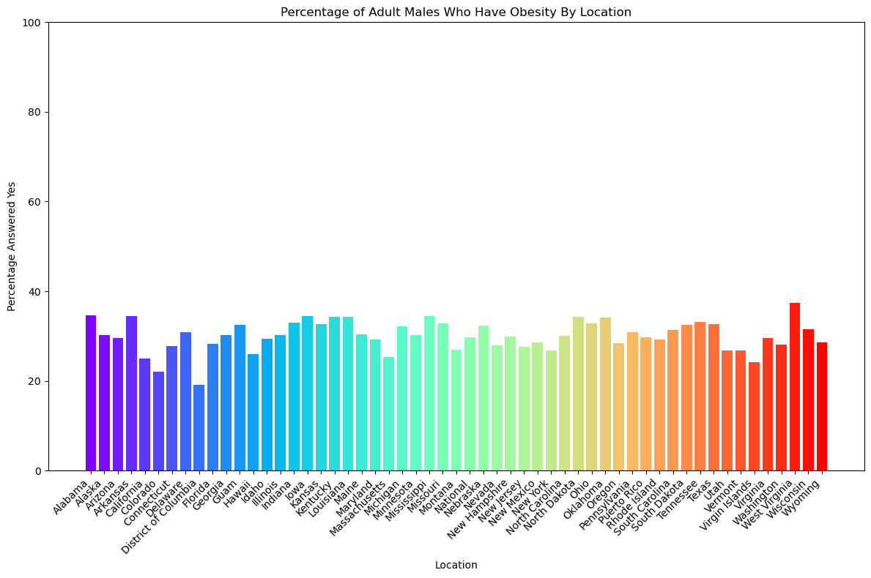
Gender

Slide 15
Next Steps
What policies are working? Which ones aren’t?
Which demographics need extra attention?
Predictive modeling: intervention and prevention

Slide 16
Citations
Centers for Disease Control and Prevention (CDC). Behavioral Risk Factor Surveillance System Survey Questionnaire. Atlanta, Georgia: U.S. Department of Health and Human Services, Centers for Disease Control and Prevention, [2023].
Centers for Disease Control and Prevention (CDC). Behavioral Risk Factor Surveillance System Survey Data. Atlanta, Georgia: U.S. Department of Health and Human Services, Centers for Disease Control and Prevention, [2023].
Physical Activity Guidelines for Americans. 2nd edition. U.S. Department of Health and Human Services, 2018.
Invisible Women. Caroline Criado Perez. 2019.

